Slide 1
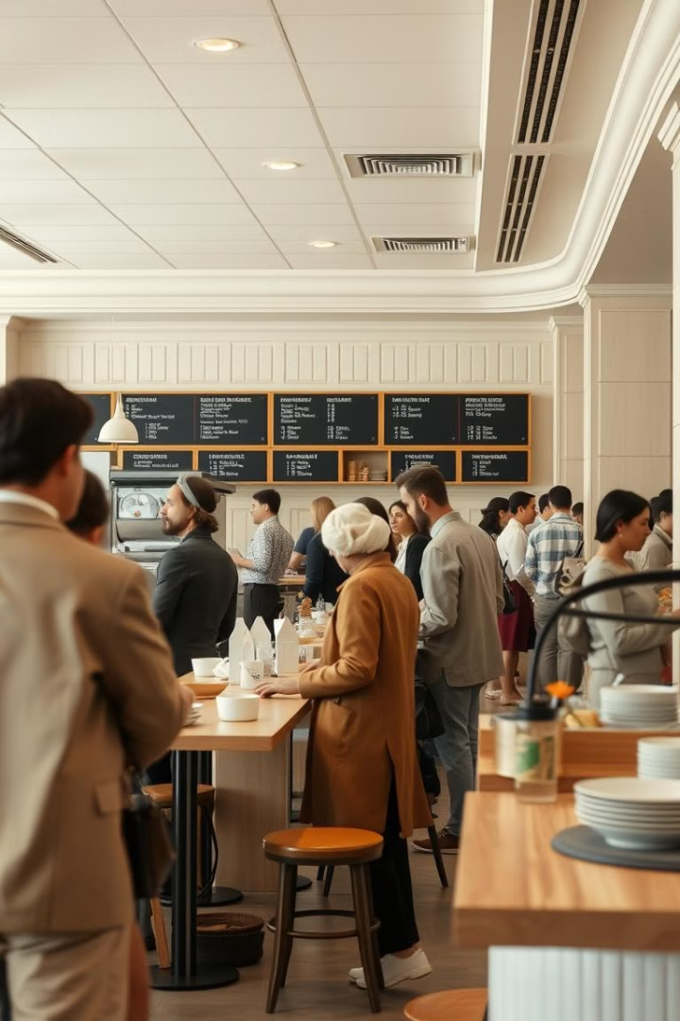
Queue Flow: Smart Cafeteria System
Streamlining cafeteria efficiency with pre-ordering, queue tracking, and peak-hour prediction. Presented by LOGIC Legends. Revolutionizing the cafeteria experience for staff and management.
- By Logic Legends

Slide 2

Cafeteria Pain Points
Long Wait Times
Average lunch line wait is 15-20 minutes. This greatly reduces employee break time.
Inefficient Staffing
Overstaffing during slow times, understaffing during peak hours causes bottlenecks.
Food Waste
Inaccurate forecasting of demand leads to excess food preparation and disposal.
Lack of Transparency
No visibility into queue length or order status causing user frustration.

Slide 3
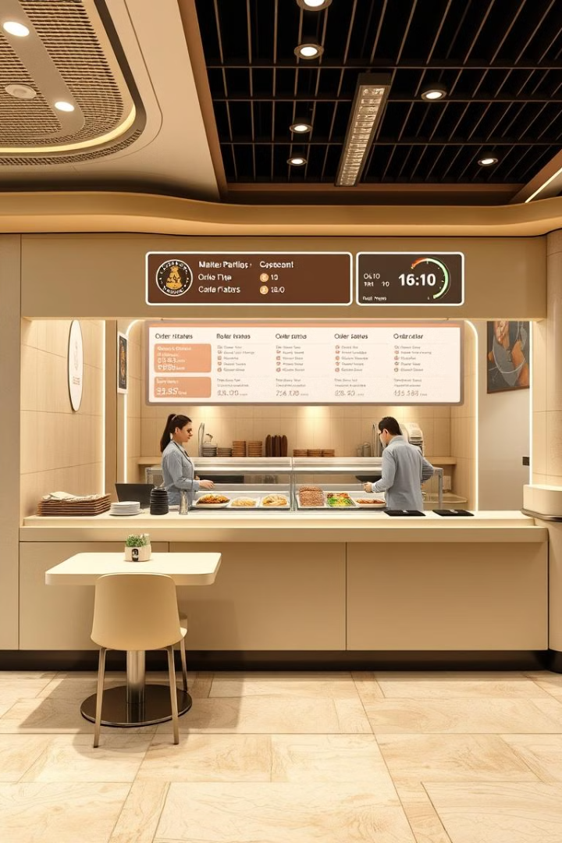
Introducing Queue Flow
Integrated System
Aims to Reduce
An integrated cafeteria system leveraging pre-ordering and real-time queue tracking.
Aims to reduce wait times, optimize staffing, minimize food waste and enhance the experience.
Seamless Integration
Integrates seamlessly with existing cafeteria infrastructure. Easy installation.

Slide 4
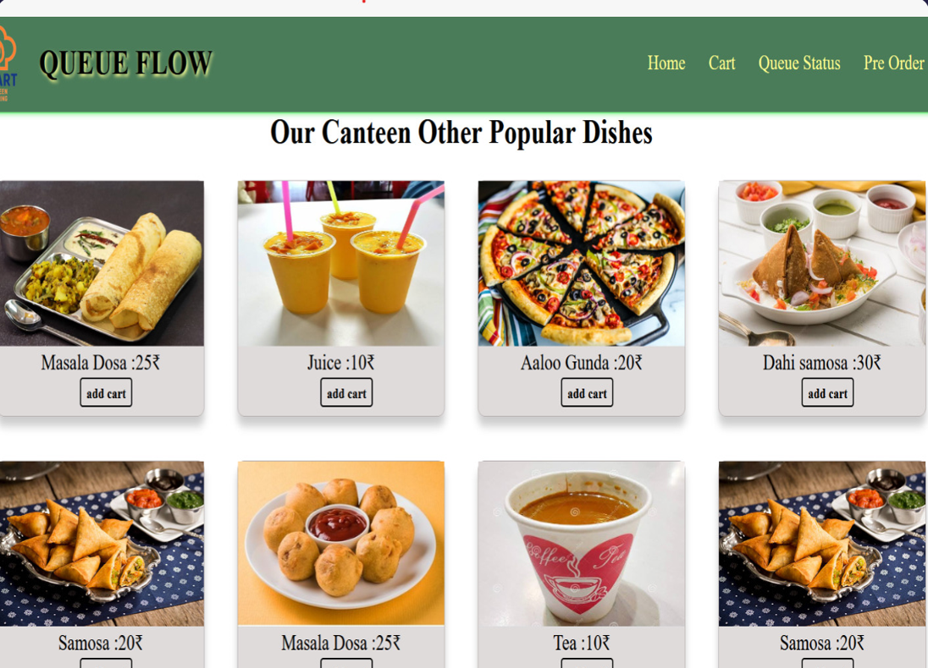

Slide 5




Pre-Ordering System
Browse Menu
Users browse the menu via mobile app or web portal.
Customize Orders
Customize orders and schedule pick-up times.
Seamless Transactions
Integration with payment gateways for seamless transactions.

Slide 6
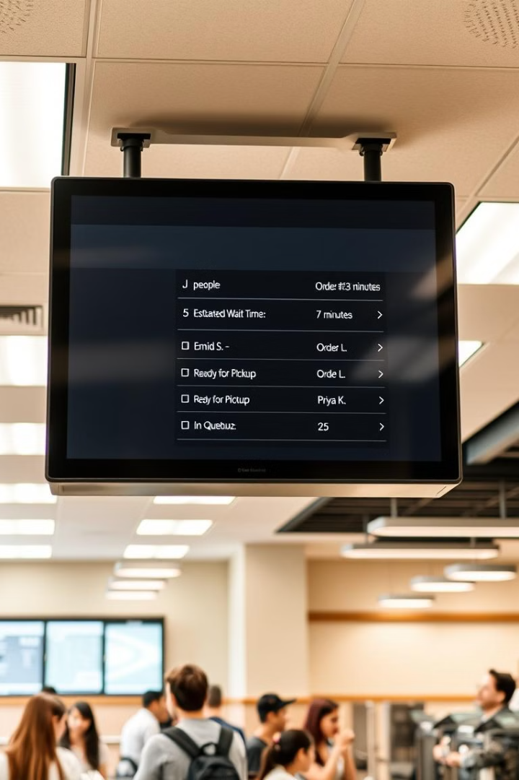



Real-Time Queue Tracking
Queue Length
Estimated Wait
Order Status
Displays queue length, estimated wait times, and order status on digital screens. A color-coded system (Green, Yellow, Red) indicates queue status.

Slide 7
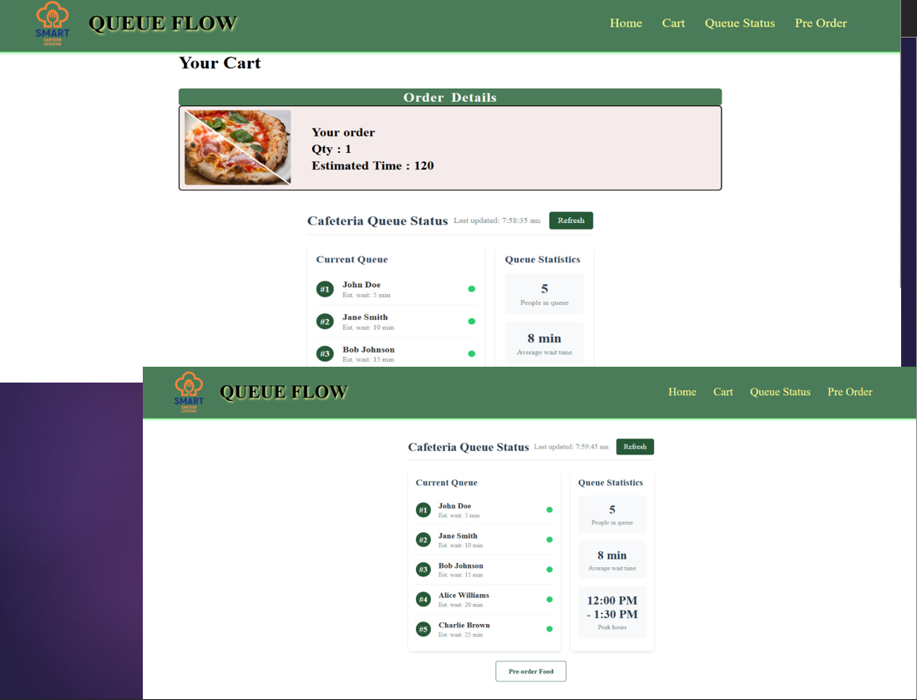

Slide 8
AI-Powered Peak Hour Prediction
Machine Learning
Data Analysis
Proactive Staffing
Uses machine learning to forecast peak hours.
Based on historical data, events, and other factors.
Enables proactive staffing adjustments.
Algorithms trained on data from similar environments achieve 92% accuracy in predicting peaks.

Slide 9



The User Journey
Pre-Order
User pre-orders via the Queue Flow app.
Queue Updates
System assigns a pick-up time and updates.
Notification
User receives a notification when ready.

Slide 10








Key Benefits
Reduced Wait Times
Enhanced Experience
Decrease average wait times by up to 50%.
Increase user satisfaction.
Food Waste
Optimized Staffing
Reduce food waste by 15% with better forecasting.
Improve staff efficiency by 20%.

Slide 11
Implementation and Integration

Slide 12
